Slide 1
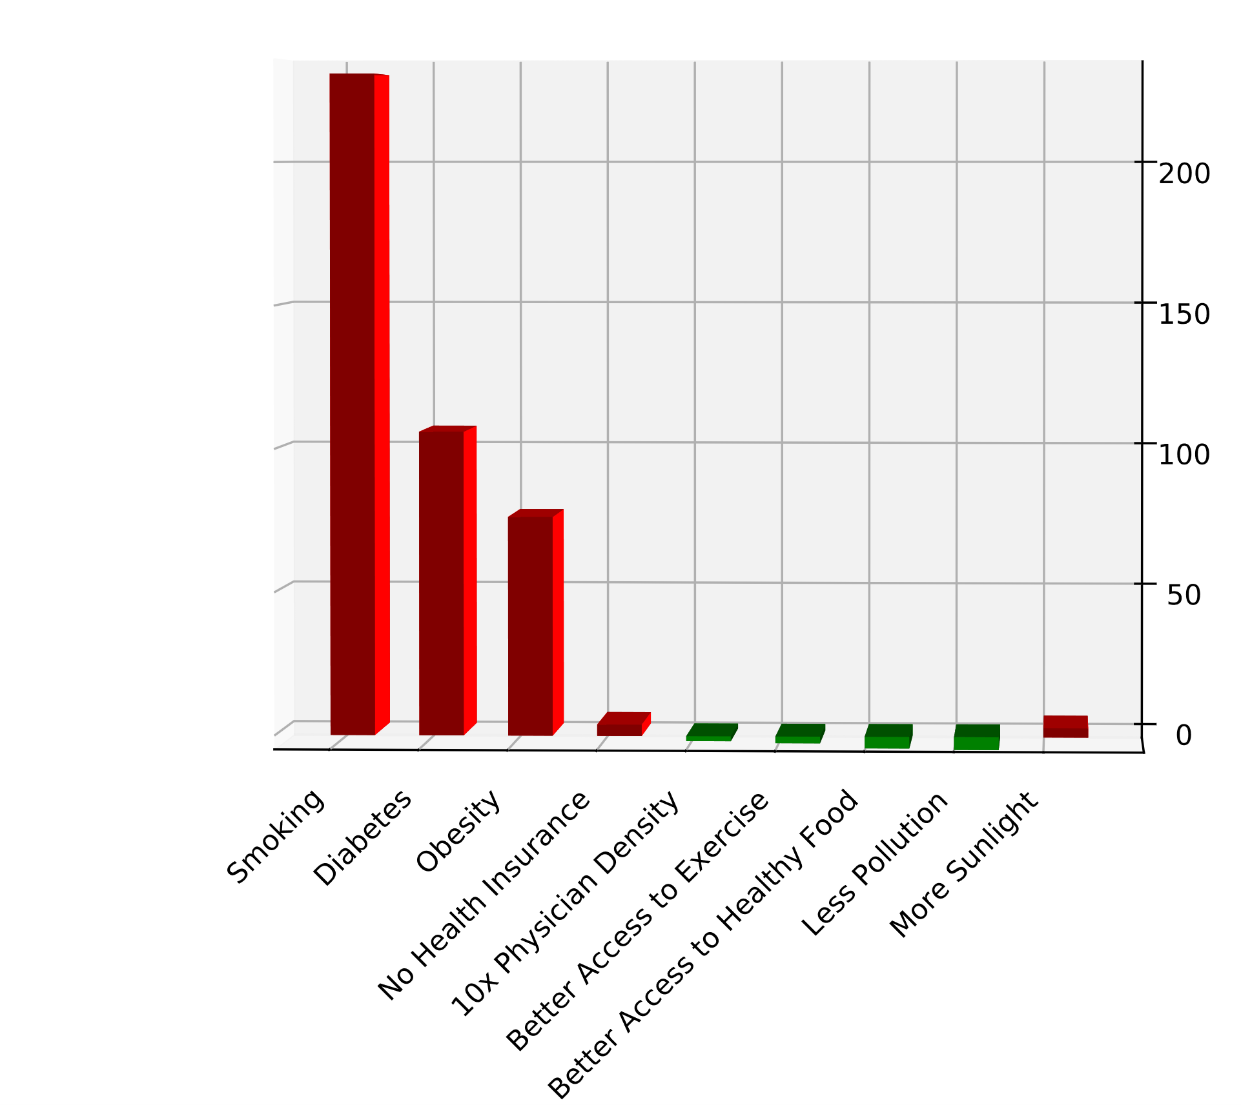
Impacts Model
Environmental factors much less important than personal behaviors
Estimated impacts from county data are qualitatively similar to those seen in longitudinal studies of individuals
Covariance analysis shows these factors are generally independent
Change in Risk (%)
Factor

